Slide 1
Finance Analysis Dashboard
Presented by SAJID SHAIKH

Slide 2
KEY FINDINGS
1
2
3
Total Revenue
$127.93 M
Total Sales after Discount
$118.73 M
Total Profit
$16.89 M
Current Month (December 2014) $12.51M
Previous Month (November 2014) $5.95M
+110.3% higher than last month
Current Month (December 2014)
$12.00M
Previous Month (November 2014)
$5.38M
+122.9% higher than last month.
Current Month (December 2014)
$2.03M
Previous Month (November 2014)
$604.60K
+235.1% higher than last month.

Slide 3
INSIGHTS
Top Product: Paseo generated the highest revenue, totaling $3.56M in the period 2013-2014.
Top Segment: The Government segment led in revenue, contributing $5.64M.
Gross Sales vs. Net Sales Comparison
Gross Sales: 45.13%
Net Sales: 51.87%
Strong Month-over-Month Performance: Sales and profit have increased significantly in the previous months.
Focus on Pricing: The average sales price per unit is relatively high, but discounts are also significant. Consider optimizing pricing strategies to improve profit margins.
Top-Performing Products and Segments: Identified the top-performing products and segments to allocate resources accordingly.

Slide 4
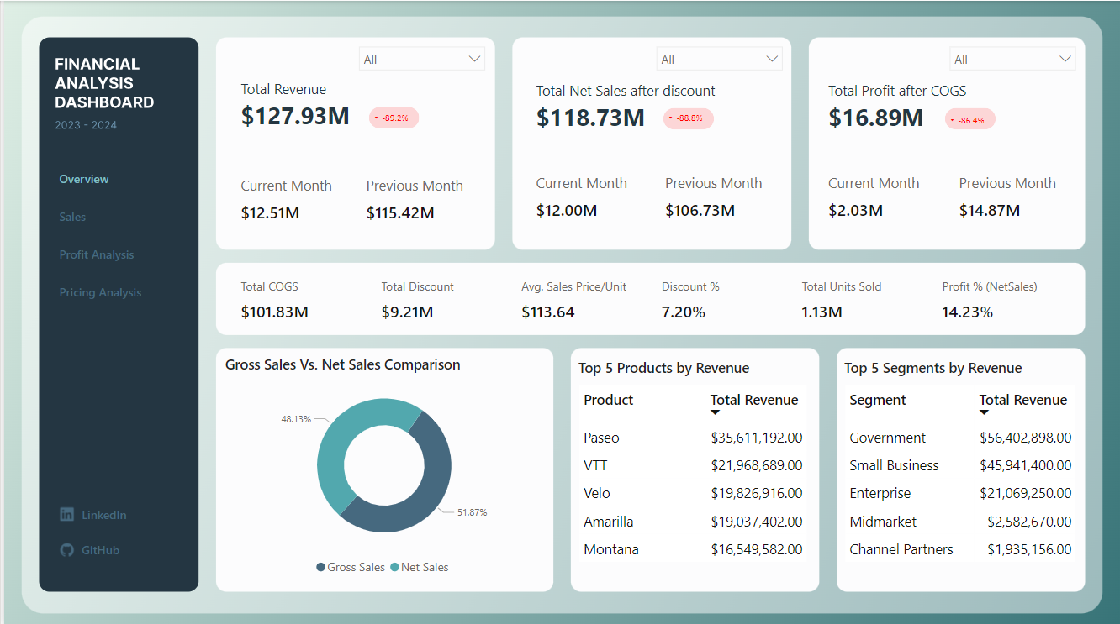

Slide 5
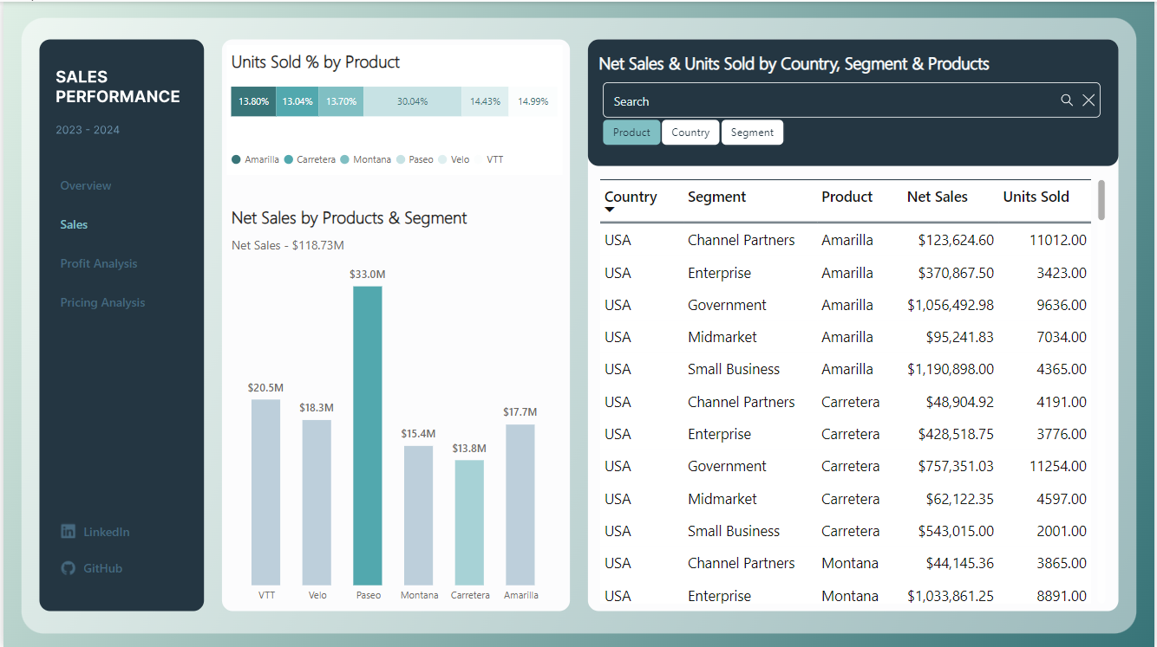

Slide 6
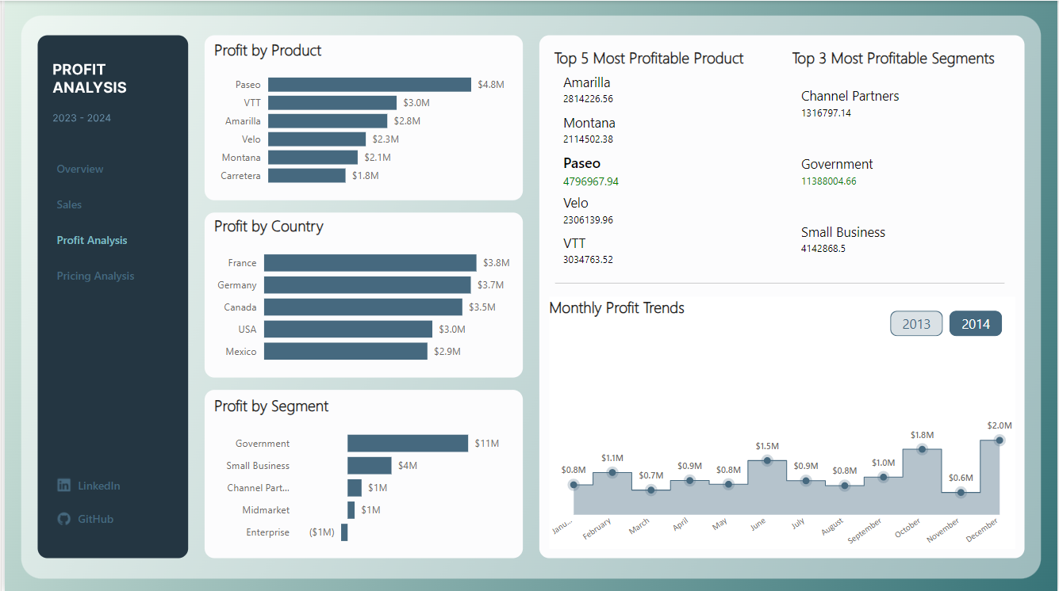

Slide 7
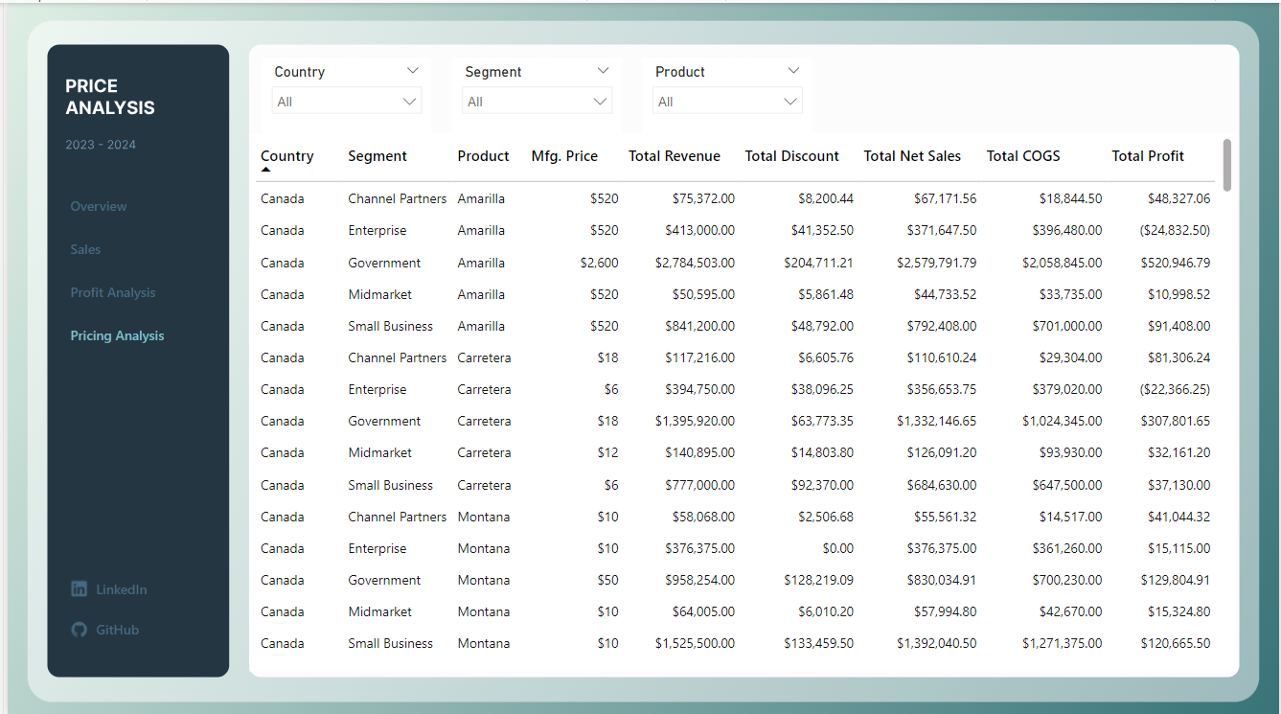

Slide 8
Thank You

